Slide 1


Amazon Prime Video Content data analysis
Flatiron Phase 1 Project
Presented By
Rashmi Chauhan

Slide 2
About the dataset
Amazon Prime is one of the most popular video streaming platforms.
This tabular dataset consists of listings of all the movies and TV shows available on Amazon Prime, along with details such as cast, directors, ratings, release year, duration, etc. as of 2021.
This dataset is taken from Kaggle.

Slide 3
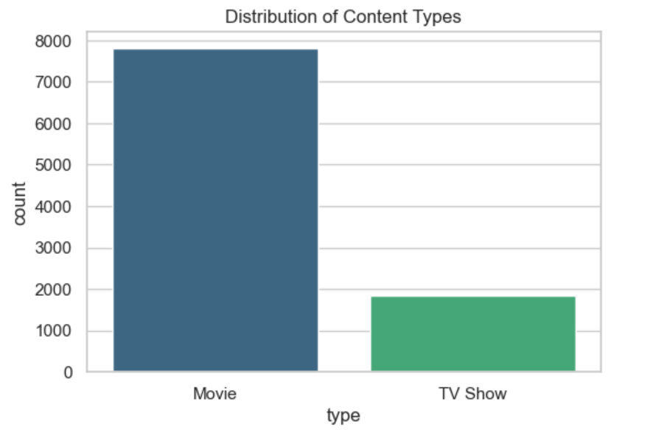
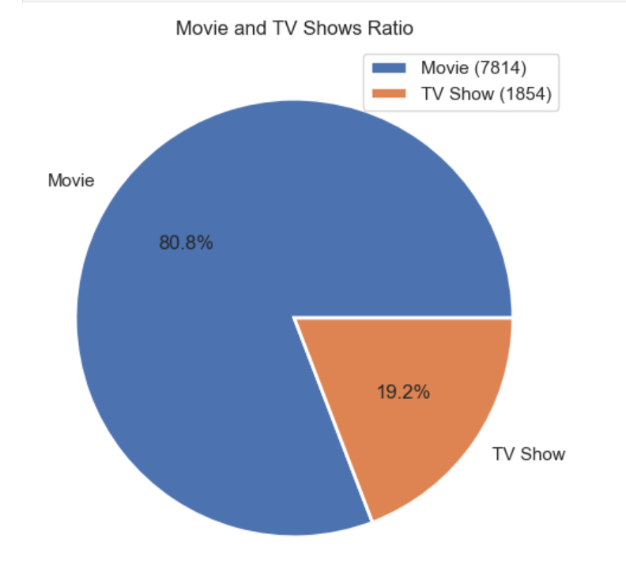
How is the content distributed across Movies & TV Shows on Amazon Prime?

Slide 4
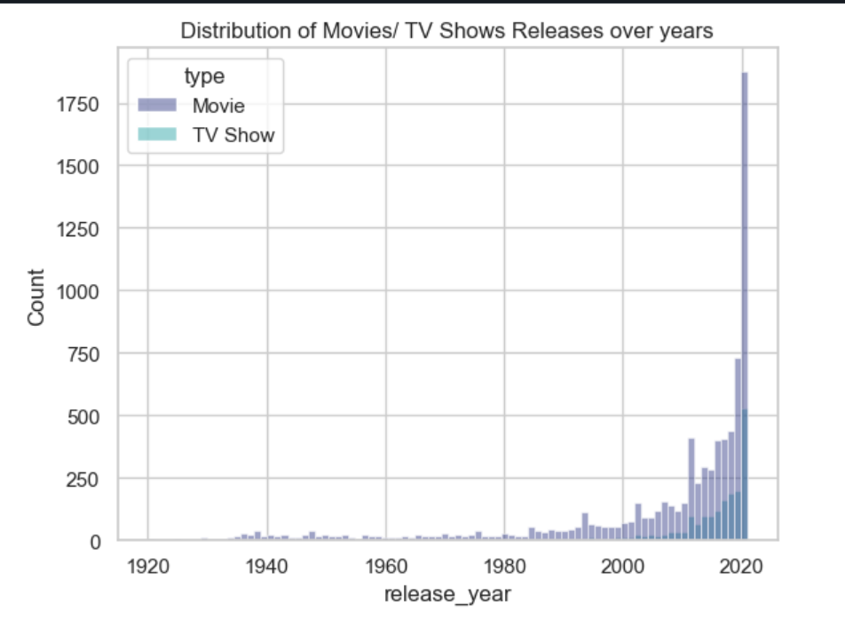
How many Movies & TV show released over the years on Amazon Prime?

Slide 5
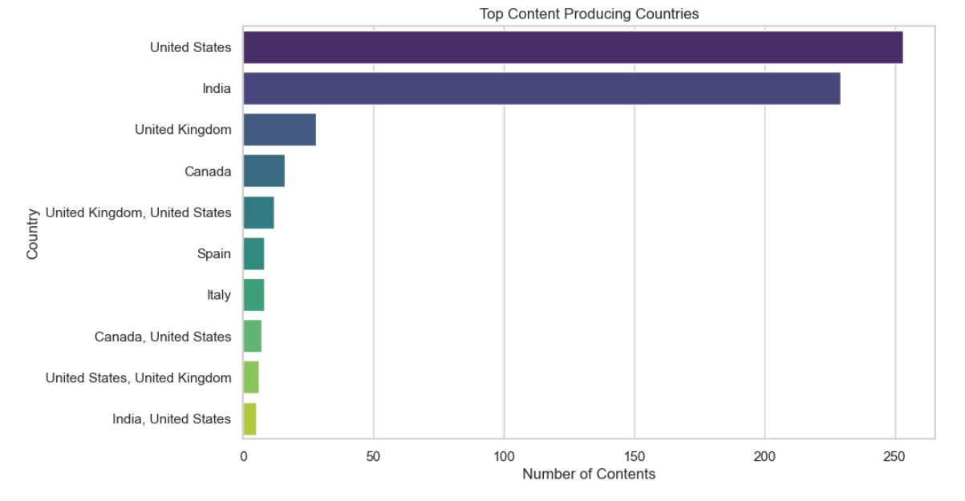
What are the Top 10 countries with the most content?

Slide 6

What are the most used words for describing Movies/ TV shows on Amazon Prime?

Slide 7
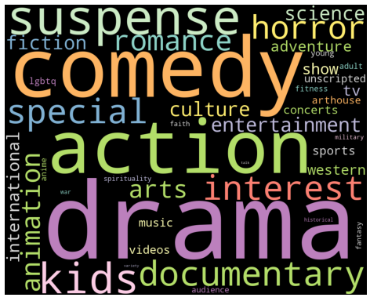
What are the most common genres of movies available on Amazon Prime?

Slide 8
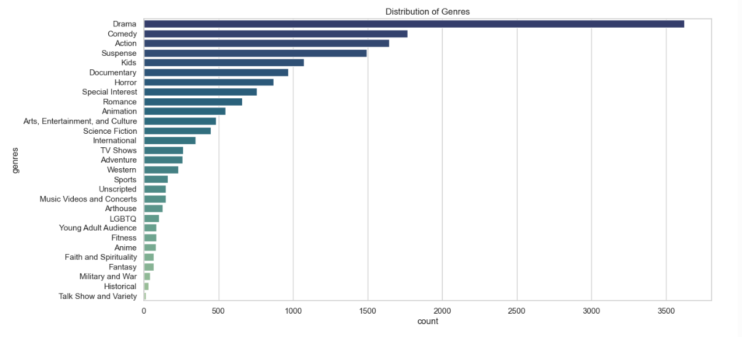
How is the Content distributed across genres?

Slide 9
Recommendations
To improve Amazon prime’s content offerings, it should invest more in TV shows.
Focus should be on both US and Indian markets.
It should diversify its content county-specific.
Analyze ratings and reviews to find the most popular content among users.
Improve recommendation systems to provide more accurate and personalized suggestions.

Slide 10
Version 2.1
Recommender system based on content.
Analysis of increase/decrease in user subscription and churn by having more customer data.
Analysis of IMDB ratings for popular content amongst users.
Comparison of Amazon Prime content with Netflix and Hulu.

